Slide 1




Sentiment Analysis on
IMDB Movie Reviews
Machine Learning Project
Team:
Date of project:
Nikola Dobricic
Milan Stankovic
Ioana Popescu
May-June 2024

Slide 2

After some of the negative reviews i heard on this movie, i was doubtful of giving it a go, but i had £3.99 in my wallet & thought i’d gamble on buying a ticket (...) i found some of the humour quite funny especially Alfred Molina’s character (...)
I suggest you give it a go. Some parts are a bit poor and the acting needs polishing. But it's watchable.
7/10
400
students

Slide 3
After some of the negative reviews i heard on this movie, i was doubtful of giving it a go, but i had £3.99 in my wallet & thought i’d gamble on buying a ticket (...) I found some of the humour quite funny especially Alfred Molina’s character (...)
I suggest you give it a go. Some parts are a bit poor and the acting needs polishing. But it's watchable.
7/10
400
students

Slide 4
After some of the negative reviews i heard on this movie, i was doubtful of giving it a go, but i had £3.99 in my wallet & thought i’d gamble on buying a ticket (...) I found some of the humour quite funny especially Alfred Molina’s character (...)
I suggest you give it a go. Some parts are a bit poor and the acting needs polishing. But it's watchable.
7/10
400
students

Slide 5
After some of the negative reviews i heard on this movie, i was doubtful of giving it a go, but i had £3.99 in my wallet & thought i’d gamble on buying a ticket (...) I found some of the humour quite funny especially Alfred Molina’s character (...)
I suggest you give it a go. Some parts are a bit poor and the acting needs polishing. But it's watchable.
7/10
400
students

Slide 6
This movie sucked. It really was a waste of my life. The acting was atrocious, the plot completely implausible. Long, long story short, these people get "terrorized" by this pathetic "crazed killer", but completely fail to fight back in any manner. (...) Like I said, this movie sucks. A complete joke. Don't let your girlfriend talk you into watching it.
1/10
400
students

Slide 7
This movie sucked. It really was a waste of my life. The acting was atrocious, the plot completely implausible. Long, long story short, these people get "terrorized" by this pathetic "crazed killer", but completely fail to fight back in any manner. (...) Like I said, this movie sucks. A complete joke. Don't let your girlfriend talk you into watching it.
1/10
400
students

Slide 8
This movie sucked. It really was a waste of my life. The acting was atrocious, the plot completely implausible. Long, long story short, these people get "terrorized" by this pathetic "crazed killer", but completely fail to fight back in any manner. (...) Like I said, this movie sucks. A complete joke. Don't let your girlfriend talk you into watching it.
1/10
400
students

Slide 9
This movie sucked. It really was a waste of my life. The acting was atrocious, the plot completely implausible. Long, long story short, these people get "terrorized" by this pathetic "crazed killer", but completely fail to fight back in any manner. (...) Like I said, this movie sucks. A complete joke. Don't let your girlfriend talk you into watching it.
1/10
400
students

Slide 10
1 | Project Scope
2 | Methodology
3 | Key Findings
Agenda

Slide 11
1. Project Scope
400
students

Slide 12
Train a model to predict a rating (on a scale from 1 to 10) based on the text of IMDB movie reviews.
gauge public opinion on platforms where explicit ratings are not provided
extend binary sentiment classification to continuous rating
experiment with various NLP approaches
400
students

Slide 13
2. Methodology
400
students

Slide 14
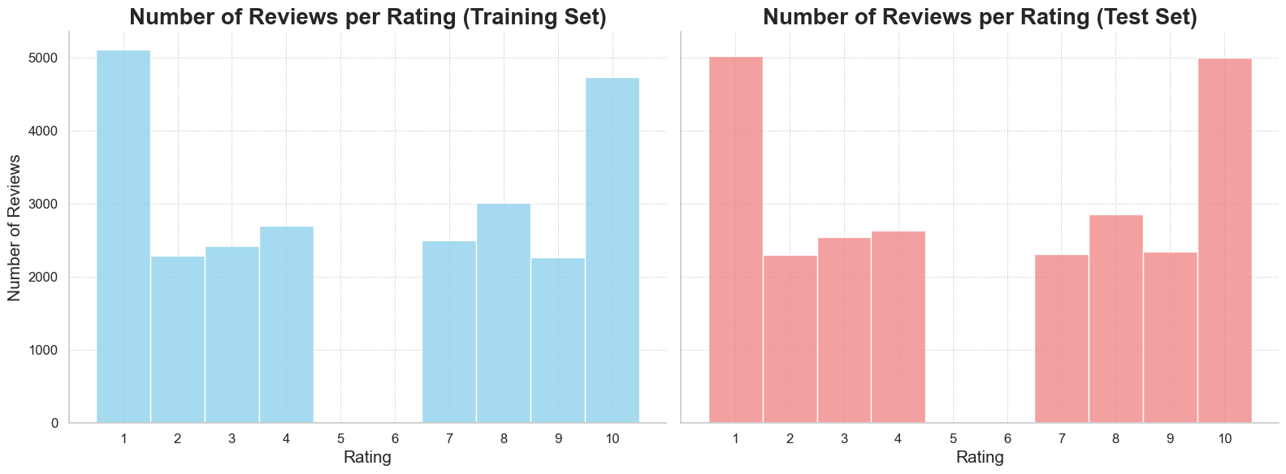
Data Prepreprocessing
Text Cleaning & Tokenization
Vizualization & Exploratory Analysis

Slide 15
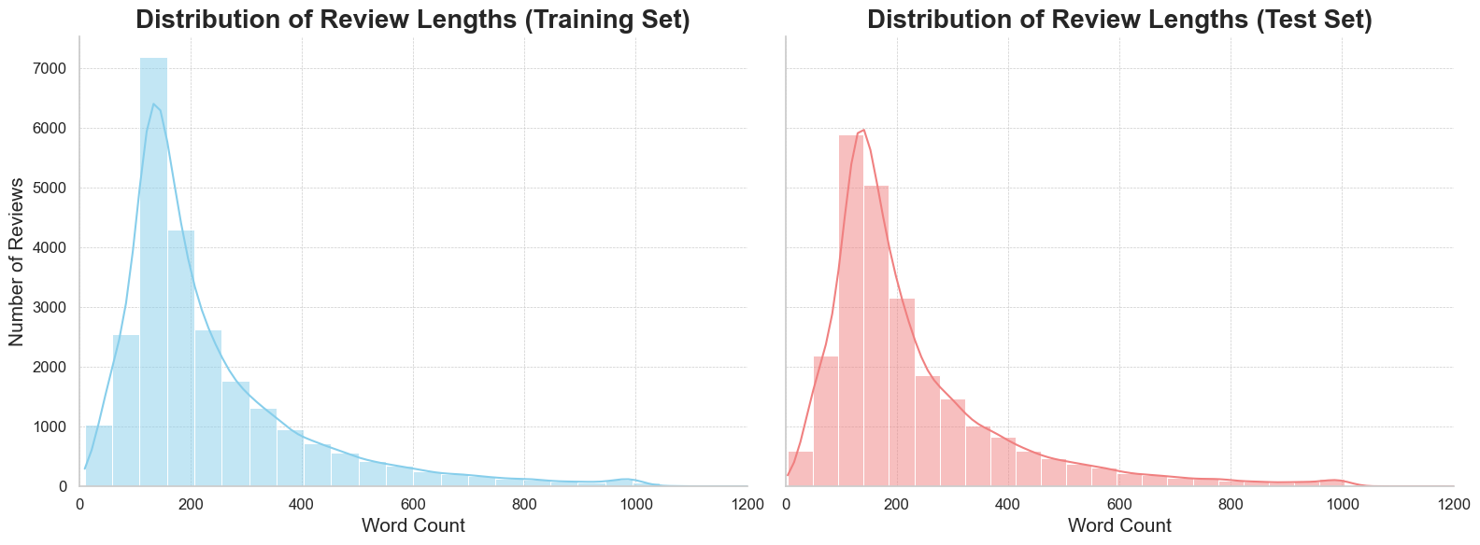

Slide 16
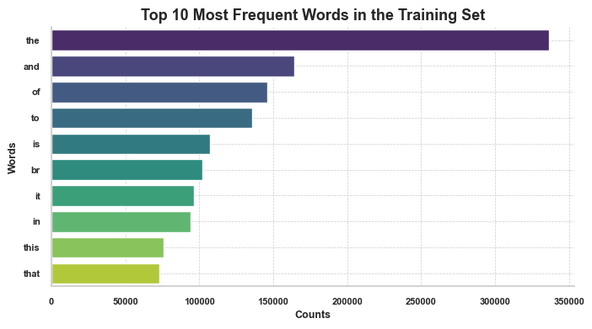

Slide 17
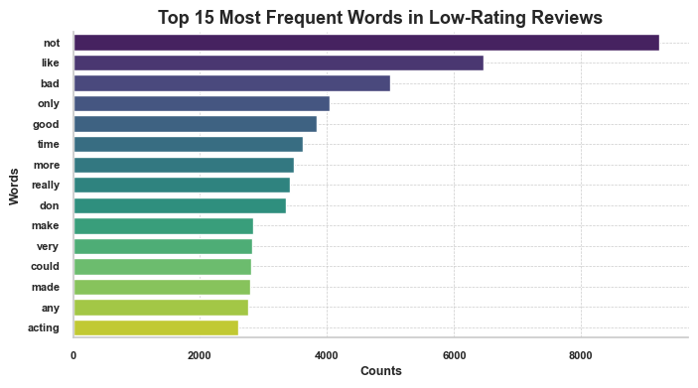

Slide 18
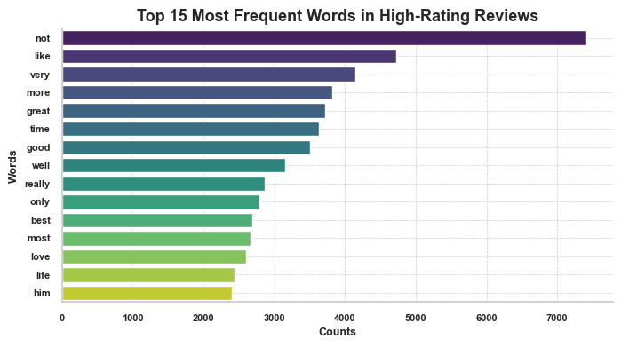

Slide 19
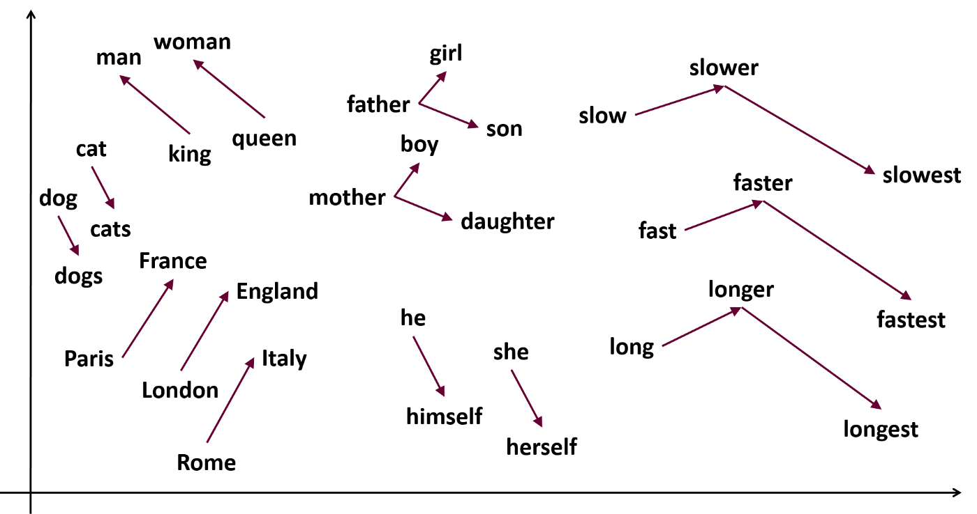
Feature Extraction
Bag of Words
Glove Embeddings
Training Embeddings
Converting text into word counts
Using pre-trained word vectors
Catered to movie-specific vocabulary
Notes:
1. partnering with epfl ai team + confirmed speakers
2. how you could contribute - we could ask a probability/ statistic question inspired by a real life trading situation
also open to estimathon
3. providing technical support

Slide 20
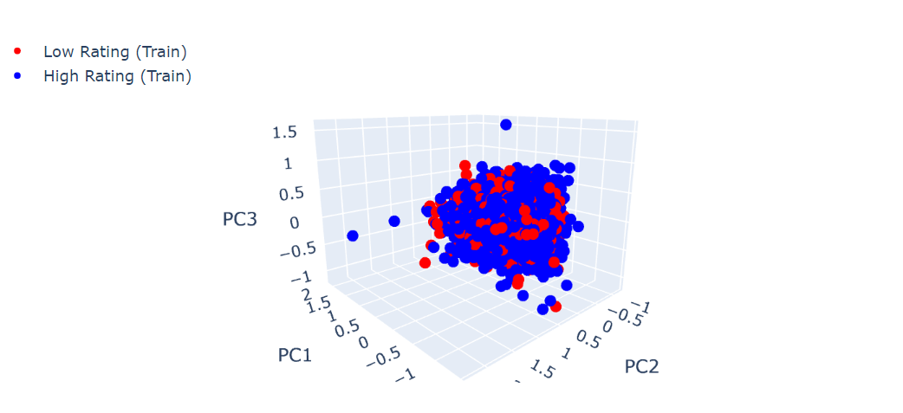
Text processing is a complex task!

Slide 21
Model Training
Bag of Words
Random Forests
baseline: Linear Regression
removed informative words
Glove embeddings
non-linear relationships
LSTMs
Bert
RNN that captures dependencies
handles varying length
trained from scratch/ pre-trained embeddings
Autoencoder using transformers
also understands context
fine-tuned last layers

Slide 22
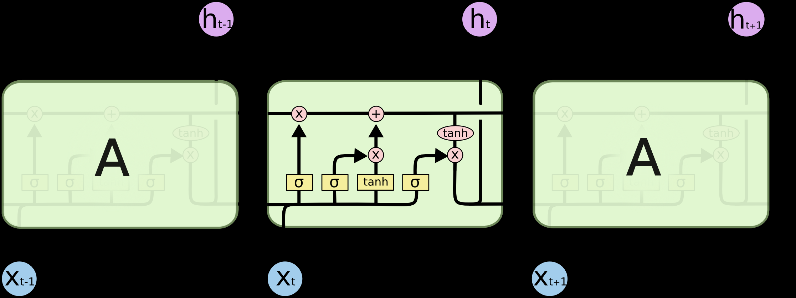
LSTM Architecture

Slide 23
3. Key Findings
400
students

Slide 24
Performance Metrics
 | Bag of Words | Bag of Words with removed words | Random Forests | LSTM | Bert
Training | - |  | Number of estimators: 300 | Loss: MSE Optimizer: Adam Epochs: 1400 | Loss: MSE Optimizer: Adam Epochs: 50
MSE | 0.17 | 0.18 | 0.10 | 0.06 | 0.03
MAE | 0.30 | 0.31 | 0.27 | 0.19 | 0.11
Precision | 0.69 | 0.67 | 0.74 | 0.83 | 0.94
Recall | 0.68 | 0.66 | 0.75 | 0.85 | 0.93

Slide 25
Most important tokens, with their coefficients:
evilest : -0.7773204948059027
reccommend : 0.659615112344284
unexpecting : 0.6172886394607975
abductions : -0.562729100747804
damnit : 0.5401431725143944
patterson : -0.5189534712902111
extremelly : -0.5118941384046103
slovenian : 0.500947631289223n
 | predicted negative reviews | predicted positive reviews
actual negative reviews | 8702 | 3798
actual positive reviews | 3885 | 8615
BOW

Slide 26
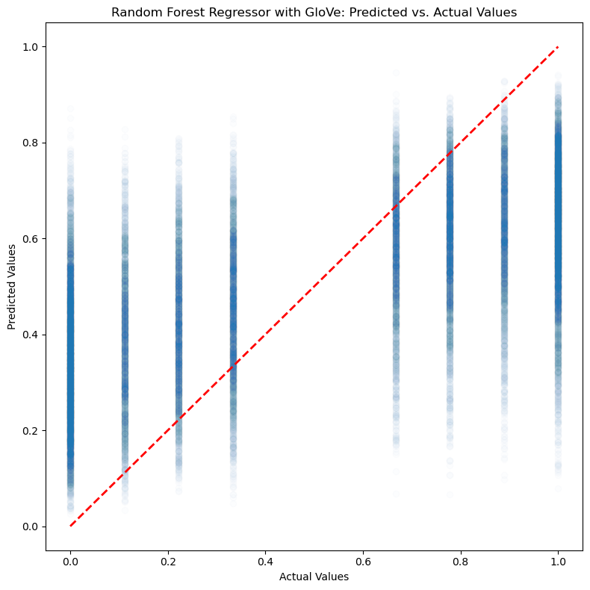
Random Forests
 | predicted negative reviews | predicted positive reviews
actual negative reviews | 9294 | 3206
actual positive reviews | 3018 | 9482

Slide 27
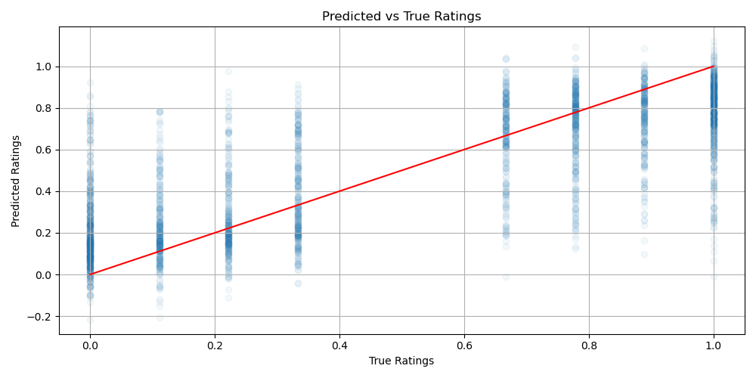
 | predicted negative reviews | predicted positive reviews
actual negative reviews | 10453 | 2047
actual positive reviews | 1864 | 10636
LSTM

Slide 28
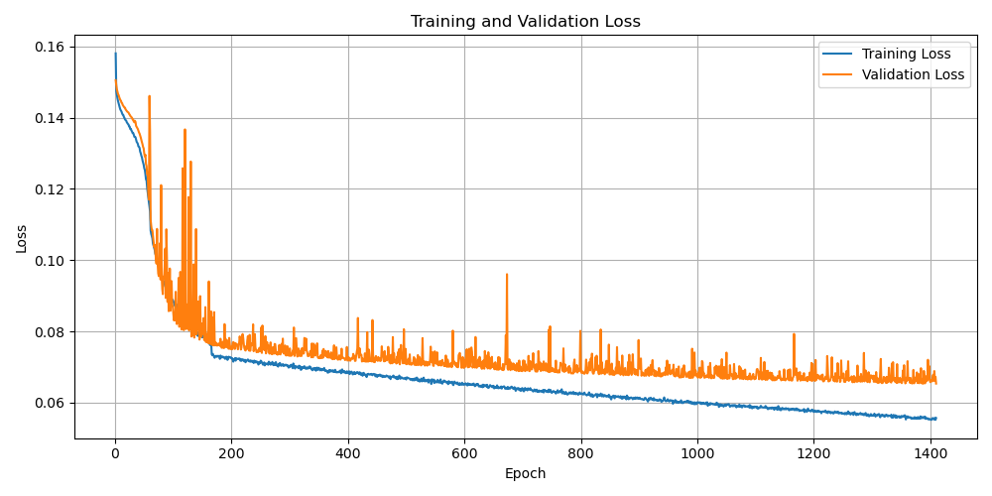

Slide 29
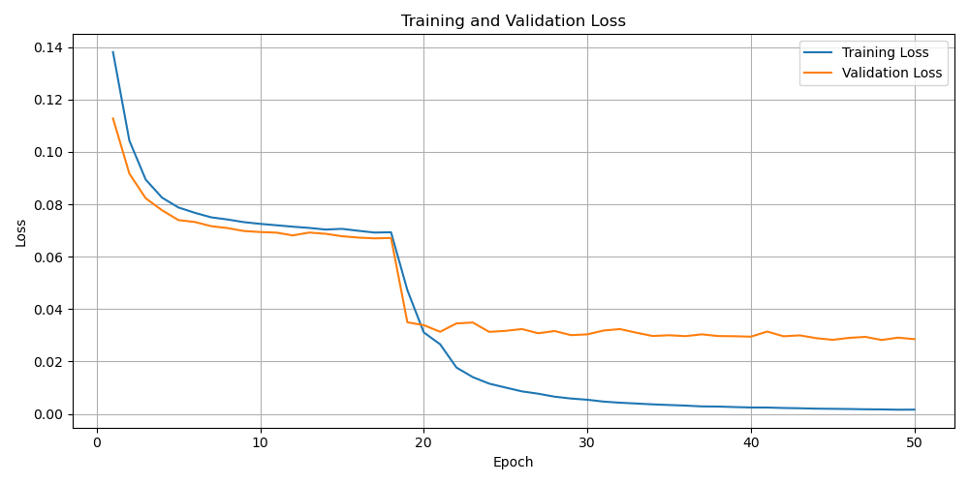
 | predicted negative reviews | predicted positive reviews
actual negative reviews | 11810 | 690
actual positive reviews | 832 | 11668
Bert

Slide 30
Interpretation
Bag of Words: simple, but ineffective due to its inability to capture context
Training embeddings worked better, as movie reviews often contain specific vocabulary and idiomatic expressions
LSTMs and BERTs are best suited, although more computationally heavy

Slide 31
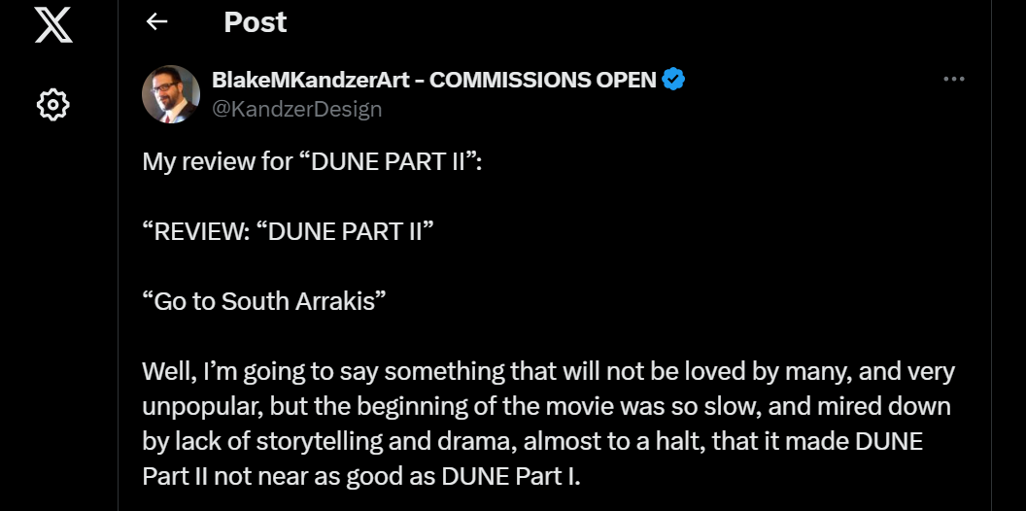
Future Steps

